Slide 1


Consistency when executing operations concurrently
SE3331-1 (2025 Fall)
IPADS, Shanghai Jiao Tong University
https://www.sjtu.edu.cn

Slide 2
The topics of today’s lecture
What is consistency model & why we need it
The eventual consistency model
Implementing eventual consistency w/ various timestamps
  Non-trivial when considering user experience.

Slide 3

Motivation case: ChatAPP

Slide 4



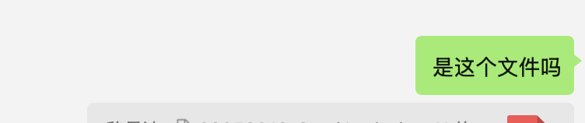
Root cause: data mismatches caused by operations order mismatches
Alice
Post (xxx 文件）
Post (是这个文件吗（ref xxx））
Data: the rendered chat history
Operations:
  Post: add an item to the history
  Read: read the history and render it on a device

Slide 5


Root cause: data mismatches caused by operations
Alice
Post (xxx 文件）
Post (是这个文件吗（ref xxx））
Bob
Post (是这个文件吗（ref xxx））
Read (xxx）
Post (xxx 文件）

Slide 6
Question: how does order mismatch happens?
Depends on how the ChatAPP is implemented

Slide 7
Implementing ChatAPP: a (naïve) centralized approach
Use a centralized server to coordinate the chats (The most simple one!)
  Data structure: a list of items, each item can be a file or a sentence
Centralized
Chat server
  [ file_a, “是这个文件吗”, … ]

Slide 8
Implementing ChatAPP: a (naïve) centralized approach
System model: use a centralized server to coordinate the chats
  Data structure: a list of sentences (or files)
  Operations: post(msg/file), read(聊天记录/文件) via RPC
Post (xxx 文件）
Post (是这个文件吗（ref xxx））
Post: append to the tail
Centralized
Chat server
[file ]
  [ file, “是这个文件吗”, …]
Read (聊天记录）

Slide 9
Question: can centralized approach reorder operations?
No, as long as we have a single server, and each users strictly use server’s response as the completion of the requests
Post (xxx 文件）
Post (是这个文件吗（ref xxx））
Centralized
Chat server
[file ]
  [ file, “是这个文件吗”, …]
Read (聊天记录）

Slide 10
But, what are the cost of not exposing reordered ops?
In practice, we rarely see ChatAPP adopts this implementation
Issues #1: Long response time, must wait for the server acks for each request
Post (xxx 文件）
Post (是这个文件吗（ref xxx））
Response
Centralized
Chat server
[file ]
  [ file, “是这个文件吗”, …]
Read (聊天记录）

Slide 11
But, what are the cost of not exposing reordered ops?
In practice, we rarely see ChatAPP adopts this implementation
Issues #2: Slow upon reads, especially when the history is long
Post (xxx 文件）
Post (是这个文件吗（ref xxx））
Centralized
Chat server
[file ]
  [ file, “是这个文件吗”, …]
  [ file_a, “是这个文件吗”, …]
Read (聊天记录）

Slide 12

But, what are the cost of not exposing reordered ops?
In practice, we rarely see ChatAPP adopts this implementation
Issues #3: Cannot work with offline
Post (xxx 文件）
Post (是这个文件吗（ref xxx））
Centralized
Chat server
[file ]
  [ file, “是这个文件吗”, …]

Slide 13
But, what are the cost of not exposing reordered ops?
In practice, we rarely see ChatAPP adopts this implementation
Issues #4: Cannot deal with server failures
Post (xxx 文件）
Post (是这个文件吗（ref xxx））
Centralized
Chat server
[file ]
  [ file, “是这个文件吗”, …]

Slide 14
Existing systems (like WeChat) replicates the data
Stores a chat on every participants (Replicated list)
  I.e., users, devices of a user, and the server
The list is replicated to enhance reliability + support offline operations
[ ]
[ ]
…
[ ]
[ ]

Slide 15
Question: how to implement post in this system?
Most efficient: only update the local data
  Problem: how to synchronize data across replicated data?
Post(你好）
[ ]
[“你好”， ]
[ ]
[ ]
…
The data becomes inconsistent!
[ ]
[ ]
[ ]
[ ]

Slide 16
Post(Write) in a system with replicated data
Data synchronization problem: how many data replica do we need sync
  Approach#1: sync with all the servers
Issue: no availability & the performance is slow
Post(你好）
[ ]
[“你好”， ]
[“你好”， ]
[ ]
[ ]
[ “你好”， ]
…
[ ]
[ ]
[“你好”， ]
[ ]
[ ]
[ “你好”， ]

Slide 17
Post(Write) in a system with replicated data
Data synchronization problem: how many data replica do we need sync
Common approach (like sync)
  Contact a few servers, reply if some acknowledged the post
Post(你好）
[ ]
[ ]
[”你好”， ]
[ ]
[ “你好”， ]
…
[ ]
[ ]
[ ]
[ ]

Slide 18
Question: how to implement read in this system?
Most efficient: read the local copy
  Pros: can work with offline
  Cons: may miss the most up-to-date data
Read(） // can work with offline
[ ]
[ ]
…
[ ]
[ ]

Slide 19

Question: how to implement read in this system?
A common solution: read the local copy + periodically sync
  e.g., periodically heartbeat, e.g., per 10 seconds
  Or via service provider, e.g., Apple Push Notification service; batch multiple sync together
Read(）
Sync()
Read(）
[ ]
[ ]
[“你好”， ]
[ ]
[ “你好”， ]
[ “你好”， ]
…
[ ]
After some interactions
Talked later
[“你好”， ]
[“你好”， ]
[ ]
[ “你好”， ]
[ “你好”， ]

Slide 20
Sync in a system with replicated data
Challenges
  How many servers to sync?
  Sync what? Operations or the data (e.g., list) ?
  What to do if different servers receive different orders of events?

Slide 21
Sync in a system with replicated data
  Common approach: sync with only a few servers
  Using operations instead of the data, because we cannot identify which data is correct
  Using filter-then-append to update the local updates (naïve)
Read(）w/ sync
[ ]
[ ]
[“你好”，“谢谢”]
[ ]
[ “你好”， ]
[ “你好”， ]
…
[ ]
After some interactions
Talked later
[“谢谢”， ]
[“你好”， ]
[ ]
[ “你好”， ]
[ “你好”， ]

Slide 22
Question: can replicated approach reorder operations?
Alice
Post (xxx 文件）
Post (是这个文件吗（ref xxx））
Bob
Post (是这个文件吗（ref xxx））
Read (xxx）
Post (xxx 文件）

Slide 23
Question: can replicated approach reorder operations?
Post(xxx 文件）
Post(是这个文件吗（ref xxx） ）
[ file， ]
[ file，”是…” ]
[ ]
[ ]
[ file， ]
…
[”是…” ]
[ ]
[ ]
[”是…” ]
Sync()
23

Slide 24
How to cope with the complexity of distributed data read/write sync?
Application developers typically assume a centralized setups
  The simplest form
So, there is typically an Infra team to handle all these
  Developers only tell what they want
How the infra team communicate with the developers?
  In our case, using a consistency model to tell what can happen & cannot happen

Slide 25
Consistency model
Consistency model defines rules for the apparent order and
visibility of updates (by different observers) , and it is a continuum with tradeoffs.
        - Todd Lipcon
No Right or Wrong consistency models
  Tradeoffs between ease of programmability & performance
Consistency is hard in (distributed) systems
  Data replication (& caching)
  Concurrency (multi-core & multi-host)
  Failures (e.g., single-machine & multi-machines )

Slide 26
Spectrum of Consistency Models
Better performance/
Fault tolerance
Sequential
Strict
Eventual
Causal
Linearizability
Easy to use
Note that many other models exists

Slide 27
The question now becomes: what is the desired model of a system? And is it possible to implement?

Slide 28
Back to our example (ChatAPP)
What is the desired model of our replicated list?
Post(xxx 文件）
Post(是这个文件吗（ref xxx） ）
[ file， ]
[ file，”是…” ]
[ ]
[ ]
[ file， ]
…
[”是…” ]
[ ]
[ ]
[”是…” ]
Sync()
28
28

Slide 29
Goal #1: always on
If my phone is connected to the network, we should send the message!
Post(xxx 文件）
Post(是这个文件吗（ref xxx） ）
[ file， ]
[ file，”是…” ]
[ ]
[ ]
[ file， ]
…
[”是…” ]
[ ]
[ ]
[”是…” ]
Sync()
29
29
29

Slide 30
Goal #2: read consistency?
i.e., each read always represents the latest & same results at the point
Post(xxx 文件）
Post(是这个文件吗（ref xxx） ）
[ file， ]
[ file，”是…” ]
[ ]
[ ]
[ file， ]
…
[”是…” ]
[ ]
[ ]
[”是…” ]
Sync()
i.e., can we allow this happen?
30
30
30
30

Slide 31
Goal #2: read consistency?
1. Not possible (consider CAP in previous lectures); 2. ChatAPP can tolerate temporal inconsistency
Post(xxx 文件）
Post(是这个文件吗（ref xxx） ）
[ file， ]
[ file，”是…” ]
[ ]
[ ]
[ file， ]
…
[”是…” ]
[ ]
[ ]
[”是…” ]
Sync()
31
31
31
31

Slide 32
Goal #2: eventual data consistency
Eventually all the data becomes the same
What is the desired model of our system?
Post(xxx 文件）
Post(是这个文件吗（ref xxx） ）
[ file， ]
[ file，”是…” ]
[ file，”是…” ]
[ ]
[ file， ]
[ file，”是…” ]
[ ]
…
[”是…” ]
[ file，”是…” ]
[ ]
[ ]
[”是…” ]
[ file，”是…” ]
Sync()
32
32

Slide 33
Eventual consistency
A specific weak consistency model, informally:
  All servers eventually receive all writes, and servers holding the same set of writes will have the same data contents
  Thus, if no new updates are made to the data, eventually all accesses will return the last update value
No restrictions on read/write, can freely choose the solution for “always-on” experience!
  Read: return the latest local copies of the data
  Write: write locally (and directly returns), propagate the writes to all the servers in background (e.g., upon sync), which is the optimal

Slide 34
Implementing an eventually consistency system
A specific of weak consistency model, informally:
  All servers eventually receive all writes, and servers holding the same set of writes will have the same data contents
  Thus, if no new updates are made to the data, eventually all accesses will return the last update value
The servers periodically sync w/ each other

Slide 35
Syncing: exchange received posts so far
X
Y
Client
SRV1
SRV2
iPhone
Post X
Post Y
sync
X (pos=10)
Y (pos=10)
Y (pos=11)
Time
X (pos=11)
Will Server1 show X in front of Y, and Server2 show Y in front of X?
Challenge: how to decide the ordering?

Slide 36
Solution: deterministic sort all posts upon syncing
Syncing: ensure both nodes have the same updates in log
Ordered list of updates at each node
  Record the updates in a log, and sort it according to the same order
X
Y
Client
SRV1
SRV2
iPhone
Post x
Post Y
sync
Post X
Post Y
Post Y
Time
Post X
Log
Log
Notes:
不能直接apply；要delay
sync：保证大家的write都一样了；然后再apply
讲动画

Slide 37
Solution: deterministic sort all posts upon syncing
Syncing: ensure both nodes have the same updates in log
Ordered list of updates at each node
  Record the updates in a log, and sort it according to the same order
X
Y
Client
SRV1
SRV2
iPhone
Post X
Post Y
Sort
sync
Sort
Post X
Post X
Post Y
Time
Post Y
Log
Log
Notes:
不能直接apply；要delay
sync：保证大家的write都一样了；然后再apply
讲动画

Slide 38
Solution: deterministic sort all posts upon syncing
Syncing: ensure both nodes have the same updates in log
Ordered list of updates at each node
  Record the updates in a log, and sort it according to the same order
Re-apply sorted updates after the sync; overwrite existing content if necessary
X
Y
Client
SRV1
SRV2
iPhone
Post X
Post Y
sync
Post X
X
X
Post X
Post Y
Y
Time
Y
Post Y
Notes:
不能直接apply；要delay
sync：保证大家的write都一样了；然后再apply
讲动画

Slide 39
Question: how to order different posts?
Syncing: ensure both nodes have the same updates in log
Ordered list of updates at each node
  Record the updates in a log, and sort it according to the same order
X
Y
Client
SRV1
SRV2
iPhone
Post X
Post Y
Sort
sync
Sort
Post X
Post X
Post Y
Time
Post Y
Log
Log
Notes:
不能直接apply；要delay
sync：保证大家的write都一样了；然后再apply
讲动画

Slide 40
Some questions about the ordering
Can we use the time T as the sort key?
  e.g., getTimeOfDay() on the local device

Slide 41
No. We need a total order among operations
Total order: every event’s timestamp is comparable
Sort key: <time T, node ID> （Break the tie using node ID)
<10, Srv1>: message X at 10th or 11th position for chat#1
<20, Srv2>: message Y at 10th or 11th position for chat#1
X
Y
iPad
SRV1
SRV2
iPhone
Post X
Post Y
sync
<10, SRV1> Post X
X (pid=10)
X (pid=10)
<10, SRV1> Post X
<20, SRV2> Post Y
Y (pid=11)
Time
Y (pid=11)
<20, SRV2> Post Y
Log
Log
Notes:
对于stable和不stable的排序算法而言，都不work

Slide 42
Some questions about the ordering
Can we use the time T as the sort key? No.
Can we use <node ID, time T> as the sort key?
Can <time T, node ID> as the key prevents the following thing happen:
  List becomes: [ “请看文件 ref (file_a)”， fila_a]

Slide 43
Some questions about the ordering
Why do we need the “node ID” as the sort key?
Can we use <node ID, time T> as the sort key?
Can <time T, node ID> as the key prevents the following thing happen:
  List becomes: [ “请看文件 ref (file_a)”， fila_a]
If the goal is to support eventual consistency, the question is Yes. But for user experience, it is no.
  Why? Consider the question #3 listed above. The answer is Yes. Do you think it is an ideal result?

Slide 44
How inappropriate orders can happen upon sync
Time=11
Time=8
X
X
iPad
SRV1
SRV2
iPhone
Post (file_a)
Sees fila_a
sync
Fila_a <10, Srv1>
Note that we assume updates apply to local storage immediately
  So that we can see the latest results
  Inconsistency will be rollback and replay later

Slide 45
How inappropriate orders can happen upon sync
Time=12
Time=9
X
iPad
SRV1
SRV2
iPhone
Post (file_a)
Post(“请看文件 ref (file_a)”)
Fila_a <10, Srv1>
Srv2 re-run “post(file_a)”
Post(“请看文件 ref (file_a)”) <9, Srv2>

Slide 46
How inappropriate orders can happen upon sync
Time=13
Time=10
X
iPad
SRV1
SRV2
iPhone
Post (file_a)
Post(“请看文件 ref (file_a)”)
sync
Fila_a <10, Srv1>
post(file_a)
Post(“请看文件 ref (file_a)”) <9, Srv2>
Post(“请看文件 ref (file_a)”) <9, Srv2>
post(file_a), <10, Srv1>
Sync again
Post(“请看文件 ref (file_a)”) <9, Srv2>
post(file_a), <10, Srv1>

Slide 47
Why can such ordering happen? unsynchronized clock time
Goal: clock time reflect the (real wall clock time) update order
Will update order be consistent with wall-clock time?
  E.g., if I first post a message on iPhone, and later post a message on iPad, the iphone’s time will be smaller
However, the clock time between nodes is not synchronized
Srv1 went first in wall-clock time with <10, Srv1>
Srv2 could still generate update ID <9, Srv2>

Slide 48

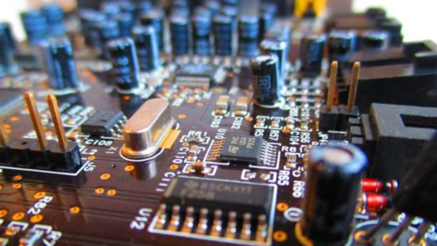
Timing: a key building block in distributed systems
How computer measure times?
  Computer has a reasonably-fixed-frequency oscillator
    E.g., quartz crystal
  Represent time interval as a count of oscillator's cycles
    time period = count / frequency
    e.g., with a 1MHz oscillator, 1000 cycles means 1msec

Slide 49
Time measuring & unsynchronized clocks
What happens when turn off the computer?
  "Real-Time Clock" (RTC) chip remains powered, with battery / capacitor
  Stores current calendar time, has an oscillator that increments periodically
Maintaining accurate time
  Accuracy: for calendar time, need to set the clock correctly at some point
  Precision: need to know oscillator frequency (drift due to age, temp, etc.)
The frequency is unsynchronized across devices
  Unless we adopted powerful hardware like atomic clock

Slide 50
Order matters, and timing on a device alone is insufficient
Time=13
Time=10
X
iPad
SRV1
SRV2
iPhone
Post (file_a)
Post(“请看文件 ref (file_a)”)
sync
Fila_a <10, Srv1>
post(file_a)
Post(“请看文件 ref (file_a)”)
Post(“请看文件 ref (file_a)”)
post(file_a)
Post(“请看文件 ref (file_a)”)
Sync again
post(file_a)

Slide 51
Ideal order: causal ordering
Definition of causal relationship: X -> Y iff
  X,Y is created on the same node and X happens before Y (single-thread)
  X, Y created by node_{i} and node_{j}, and X (e.g., post msg) “causes” Y (e.g., ref msg)
  Example
    X is add message, Y is the reference of this messages
  There exists Z, such that X -> Z -> Y

Slide 52
Sort the posts in the log using causal order preserved clocks
<Time, ID> does not preserve the causal ordering
  Why? The lock on different nodes is unsynchronized
Goal
  Clock should reflect the causal order
Idea
  Sync clock using the events dependencies
  Why possible? Because we don’t sync w/ wall clock time (doesn’t exist)

Slide 53
Solution: Lamport clock
We need causality timestamp
Lamport clock: a logical clock used to assign timestamps to events at each node, with the following goal
  If event #1 and event #2 are created on the same node, and event #1 is before event #2 (is before = < if not else mentioned)
  → TS(event #1) < TS(event #2)
  If event #1 “cause” event #2,
  → TS(event #1) < TS(event #2)
How event #1 causes event #2? Receiving messages!

Slide 54
Lamport clock algorithms
Lamport logical clock
  Each server keeps a clock T
  Increments T as real time passes, e.g., one second per second (or upon events)
  Modify T = Max(T, T’+1)
  if sees T’ from another server
Srv1: Post X with <10, Srv1>, Suppose T₁ = 10
Srv2: Sees “add X”, then update T₂ = Max(T₂, 11)
Srv2: Refs. X with <11, Srv2>
Now, causality preserving!

Slide 55
Questions on Lamport clock
If TS(event #1) < TS(event #2), what does it say about event #1 (create on node #1) and event #2 (created on node #2)?
  Event #1 occurred at a physical time earlier than event #2
  Node #1 must have communicated with Node #2
  If event #1 has been synced to node #2, then event #1 must have occurred at a physical time earlier than event #2
Notes:
No
No
Yes

Slide 56
Put it all together: Lamport clock for eventual consistency
Time=11
Time=9
X
X
iPad
SRV1
SRV2
iPhone
Post (file_a)
Sees fila_a
sync
Fila_a <10,>
Srv2 re-run “post(file_a)”
Note that we assume updates apply to local storage immediately
  So that we can see the latest results
  Inconsistency will be rollback and replay later

Slide 57
Put it all together: Lamport clock for eventual consistency
Time=11
Time=11
X
X
iPad
SRV1
SRV2
iPhone
Post (file_a)
Sees fila_a
sync
Fila_a <10,>
Srv2 re-run “post(file_a)”
Note that we assume updates apply to local storage immediately
  So that we can see the latest results
  Inconsistency will be rollback and replay later

Slide 58
Put it all together: Lamport clock for eventual consistency
Time=12
Time=12
X
iPad
SRV1
SRV2
iPhone
Post (file_a)
Post(“请看文件 ref (file_a)”)
Fila_a <10,>
Srv2 re-run “post(file_a)”
Post(“请看文件 ref (file_a)”) <12,>

Slide 59
Put it all together: Lamport clock for eventual consistency
Time=13
Time=10
X
iPad
SRV1
SRV2
iPhone
Post (file_a)
Post(“请看文件 ref (file_a)”)
sync
Fila_a <10, >
Srv2 re-run “post(file_a)”
Post(“请看文件 ref (file_a)”)
Fila_a <10, >
Post(“请看文件 ref (file_a)”) ,<12>
Causality preserving

Slide 60
Quiz: can this happen?
Assuming using Lamport Clock to implement Eventual Consistency

Slide 61
Recap of today’s lecture
What is consistency model & why we need it
The eventual consistency model
Implementing eventual consistency w/ various timestamps
  Non-trivial if consider user experience
Question: is eventual consistency so far desirable for various application scenarios?

Slide 62

Motivating case: 接龙
#接龙
第一个街上的人有100奖金
Post_{A}
Read
Alice
A: #接龙
第一个街上的人有100奖金
  Which output is desired?
B: #接龙
第一个街上的人有100奖金
Bob
Post_{B}
Time

Slide 63
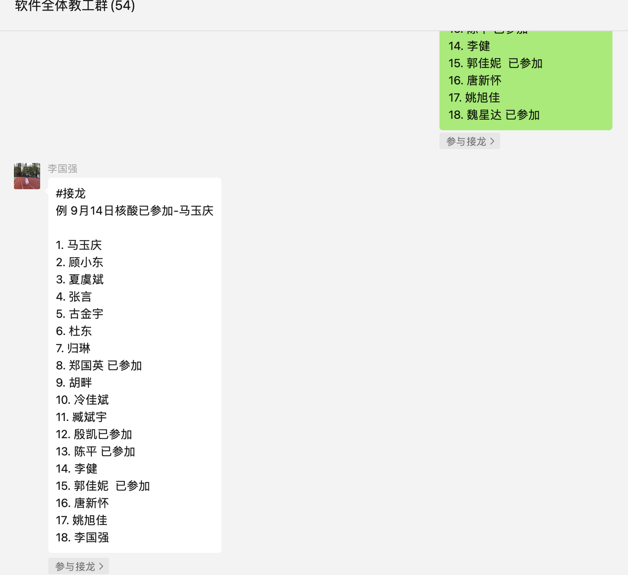
Question: can the following view happen?
#接龙
第一个街上的人有100奖金
#接龙
第一个街上的人有100奖金
A: #接龙
第一个街上的人有100奖金
B: #接龙
第一个街上的人有100奖金
Post_{A}
Read
Read
Alice
B: #接龙
第一个街上的人有100奖金
A: #接龙
第一个街上的人有100奖金
Bob
Post_{B}
Time

Slide 64
Problem: some applications require a strong ordering
And reading the temporal results that can be reordered is not desirable
  E.g., 接龙
Two solutions for our 接龙
  If we cannot determine the order of events, e.g., no casual relationship, let the application reorder them instead of directly order them
  We choose a consistency model that cannot expose reordered events

Slide 65
Motivating case: 接龙
#接龙
第一个街上的人有100奖金
Post_{A}
Read
Alice
A: #接龙
第一个街上的人有100奖金
Key problem: operations don’t have order, yet our Lamport clock gives them a total order
  Which output is desired?
B: #接龙
第一个街上的人有100奖金
Bob
Post_{B}
Time

Slide 66
Lamport clock gives a total order to events
For every pair of events, we can compare their time
  i.e., T(e1) < T(e2) or T(e1) > T(e2)
Problem: too strong
  The order may disagree with the external observer, especially for un-related events
  Sometimes we may need to identify unrelated events, e.g., in 接龙

Slide 67
Requirement: partial order
Consider two events e1 & e2, they may have
  T(e1) < T(e2)
  T(e2) < T(e1)
  Incomparable!
< means happen before
#接龙
第一个街上的人有100奖金
Post_{A}
Read
Alice
A: #接龙
第一个街上的人有100奖金
Key problem: operations don’t have order, yet our Lamport clock gives them a total order
  Which output is desired?
B: #接龙
第一个街上的人有100奖金
Bob
Post_{B}
Time

Slide 68
Realizing partial order: vector clock
Clocks are represented as a vector (one entry per server)
  Each entry corresponds to a local lamport clock on the server, and cached copies of clocks on other servers
[1, 2]
[1, 2]
Server0
Server1

Slide 69
Realizing partial order: vector clock
Clocks are represented as a vector (one entry per server)
  Each entry corresponds to a local lamport clock on the server, and cached copies of clocks on other servers
  Increments local T as real time passes, e.g., one second per second
[2, 2]
[1, 2]
Server0
Server1

Slide 70
Realizing partial order: vector clock
Clocks are represented as a vector (one entry per server)
  Each entry corresponds to a local lamport clock on the server
  Increments local T as real time passes, e.g., one second per second
Suppose we have two independent events here
Srv0: Add X with [2, 2]
Srv1: Add Y with [1, 3]
Incomparable!
[2, 2]
[1, 3]
Server0
Server1

Slide 71
Realizing partial order: vector clock
Clocks are represented as a vector (one entry per server)
  Each entry corresponds to a local lamport clock on the server
  Increments local T as real time passes, e.g., one second per second
  Modify T_{i} = Max(T_{i}, T_{i}’+1)
  if sees T from another server
Srv0: Add X with [2, 2]
Srv1: Add Y with [1, 3]
Sync
[2, 3]
[1, 3]
Server0
Server1

Slide 72
Realizing partial order: vector clock
Clocks are represented as a vector (one entry per server)
  Each entry corresponds to a local lamport clock on the server
  Increments local T as real time passes, e.g., one second per second
  Modify T_{i} = Max(T_{i}, T_{i}’+1)
  if sees T from another server
Srv0: Add X with [2, 2]
Srv1: Add Y with [1, 3]
Srv0: Ref X with [3, 4]
Sync
[3, 4]
[1, 3]
Server0
Server1

Slide 73
Lamport clock vs. Vector clock
Both capture the causal relationships between events
In comparison:
  Lamport clock: total order
  Vector clock: partial order
Once detected incomparable, let application itself to fix the problem
  Widely used in eventual consistency systems like Amazon’s dynamo
Dynamo: Amazon’s Highly Available Key-value Store, SOSP’07

Slide 74
Problem: some applications require a strong ordering
And reading the temporal results that can be reordered is not desirable
  E.g., 接龙
Two solutions for our 接龙
  If we cannot determine the order of events, e.g., no casual relationship, let the application reorder them instead of directly order them
  We choose a consistency model that cannot expose reordered events
Drawback: require application modifications

Slide 75
Choosing a stronger consistency model
Better performance/
Fault tolerance
Sequential
Strict
Eventual
Casual
Linearizability
Easy to use
Note that many other models exists

Slide 76



What does a strong consistency model presents?
From a developer’s perspective
  Everything has one copy
  The overall operations executed by the system corresponds to a serial execution
Time
The system
Reads/writes are executed concurrently
Replicated list
Time
From any observers
One logical list

Slide 77
Question: which order is the equivalence order?
Different order observed impact user experience
  E.g., If Alice post first, it should be present earlier in the list
Bob 接龙
Time
Alice 接龙
The system
Reads/writes are executed concurrently
Replicated list
Time
From any observers
One logical list

Slide 78
The desired order for 接龙: Ordered by the issue time
i.e., the order of operations is ordered by the issue time of the operation
Issue time, i.e., when the user press the button
Post_{A}
Read
Alice
Post_{B}
Bob
Desirable:
Post_{A}
Post_{B}
Read
The ordered by the issue time is called strict consistency

Slide 79
Question: how to implement a strong consistency model?
Implementation goals (e.g., for strict consistency)
  Everything has one copy (in a logical view)
  The overall operations executed by the system corresponds to a serial execution, and the order matches the issue time
One possible approach: centralized design!
Post (xxx 文件）
Post (是这个文件吗（ref xxx））
Centralized
Chat server
Post: append to the tail

Slide 80
Question: can we implement strict consistency?
Assuming we implement strict consistency using a centralized KVS
  The simplest setup we can get in a distributed setting
Question: how can the server determine to process Post_{A} first?
Post_{A}
Post_{B}

Slide 81
Challenge#1: unsynchronized clocks for the issue time
Without information, the server cannot order operations!
Question: can we add information for server to order operations?
  E.g., using the timestamp of machine at the issue time
Post_{A} + GetTimeOfDay()
Post_{B} + GetTimeOfDay()

Slide 82
Challenge#2: unbounded wait
Even with synchronized clock, is our implementation efficient?
  No, because the server needs to wait for out-of-order requests!
  And we even don’t know how many to wait! (e.g., what about packet loss?)
Post_{A} + GetTimeOfDay()
Wait
Post_{B} + GetTimeOfDay()

Slide 83
Strict consistency: strong but not practical
What is the order maintained by our centralized design?
  The order is determined by how server process the requests
Post (A）
Post (A）done
Centralized
Chat server
[A, ]
  [ A, B]
Post (B）
Post (B）done

Slide 84
Order maintained by the centralized design
For requests concurrently executed, we are unaware of the order
  E.g., whether post (A) and post (B) is executed is totally determined by when server has received the requests
Post (A）
Post (A）done
Centralized
Chat server
[A, ]
  [ A, B]
Post (B）
Post (B）done

Slide 85
Order maintained by the centralized design
For requests with known completion->issue relationship, we know the order. Why? A completion indicates an operation is done
  In this example, post(C) must be ordered after post (B)
Post (A）
Post (A）done
Post (C）
Post (C）done
Centralized
Chat server
[A, ]
  [ A, B]
Post (B）
Post (B）done

Slide 86
Strong consistency model: what is the order provided?
#1. Global issuing order (strict consistency)
#2. Global "completion-to-issuing" order (linearizability)
  Given by our centralized approach
Why linearizability is important?
  It can be implemented in a distributed setup!
  The strongest consistency model practically implemented in a distributed setup
  In contrast, the strict consistency cannot be practical implemented

Slide 87
Implementing linearizability in replicated data storage
Setup: the data (e.g., Chat history) is replicated on multiple servers
Operations submitted by different processes (e.g., phone, pad, server)
  Read: read the current data
  Write: update the current data
Goal: all observables observes a single serial execution
P0
P1

Slide 88
Implementing reads/writes in a linearizable system
Can write be processed locally, and then reorder under sync?
  No, because different device can view different orders!
Solution & principle: one writer rule
  Only one process is allowed to do the read/write
  The write order is then propagated to other processes
P0
P1

Slide 89
Primary-backup model (Minick centralized approach)
For each object, Clients send all reads/writes at a designated machine
For writes
  Primary forwards writes to all the replicas
  M0 executes writes locally (in order)
  Respond OK
Primary
Write(x,1)
Write locally
Done
P0
forward
forward
P1
Update local copy

Slide 90
What does the 「in order」 mean?
Suppose we have two writes send to the primary
  Due to network problem, the message may reorder
  If the reorder happens, it is possible that two replicas apply the same writes in a different order!
Primary
Write(x,1)
Write(x,2)
P0
1
2
forward
P1
2
1

Slide 91
In order updates: primary must use some seq number
Seq number: orders of update
  Possible implementation: a global counter
  Incremented upon receive a write request
All replica apply writes in the order of seq number
  Delay writes if the previous write has not been finished
Primary
Write(x,1)
Write(x,2)
P0
1
2
1
2
Forward <2, 1>
Forward <1, 1>
P1
0
1
2

Slide 92
Drawback of primary-backup?
Performance issues
  Fallback a centralized design, with even lower performance
    E.g., extra roundtrip, etc.
Reliability issues
  If primary crashes, others cannot work
  We will come back to the reliability issue future lectures
Notes:
性能 ：其实本质上fallback到了centralized KVS (除了对primary的访问）
可靠性：分为两部分：
1. primary挂了，没法访问了
2. backup挂了，primary没法support write了（和最初的naive approach #2一样）

Slide 93
Question: can we optimize the implementation
e.g., read only return the local copy
  Unfortunately, it is not linearizable (see the below example)
This model is sequential consistency
  Per-process issuing/completion order
Read(x)
Primary
Write(x,2)
1
Done
P0
Read(x)
Read(x)
1
2
P1

Slide 94
Choosing a stronger consistency model
Better performance/
Fault tolerance
Sequential
Strict
Eventual
Causal
Linearizability
Easy to use
Note that many other models exists

Slide 95
Eventual vs. Linearizability
Scalability
  Still have a single primary (but operations are much lightweight)
Ease of programming
  Not so easy: update function & anomalies
Fault tolerance
  As long as a single replica is up, client can work
Scalability
Ease of
programming
Performance
Consistency
Fault tolerance

Slide 96
Summary of today’s lecture
What is consistency model & why we need it
The eventual consistency model
Implementing eventual consistency w/ various timestamps
  Non-trivial if consider user experience
Strong consistency models, strict consistency & linearizability
Note that we use a ChatAPP as our example, but the model generalize
  The data can be any data structure
  The operations can be any operations updating the data

